Slide 1




DAB-16
Data Sprint Project
Data Sense Company
Zainab Alsaffar
Zainab Ahmed
Heba Alqassab
Hameeda Ebrahim

Slide 2





Agenda
1
Scenario
4
Analysis
Theory lesson
2
Approaches
5
Recommendations
3
Definitions
6
Limitations

Slide 3





Scenario
Olist, a leading Brazilian e-commerce platform, had built its growth on aggressive digital marketing and promotional campaigns. While these efforts successfully brought in a large volume of first-time buyers, repeat purchases and long-term customer loyalty remained below expectations. They approached us to answer a critical question: How can we use behavioral data to understand and improve customer experience?

Slide 4
Approaches
1
Regional Loyalty Insights (Brazil)
4
Category Impact on Loyalty
Theory lesson
2
Customer Loyalty & Churn Drivers
5
Review Behavior Analysis
3
Seasonal & Monthly Customer Trends
6
Delivery Speed & Retention

Slide 5




E-commerce
A marketplace connecting small and medium businesses with online customers.

Slide 6





B2B
Olist connects SMBs to major marketplaces and manages their sales, inventory, and orders.

Slide 7
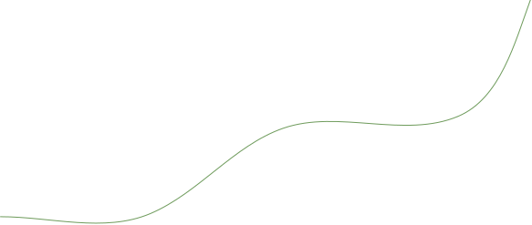

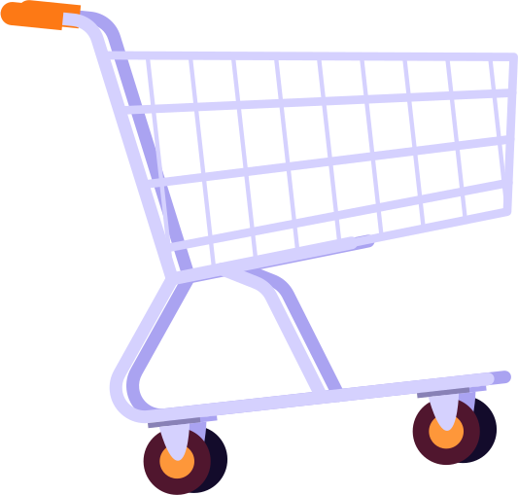


01
Analysis

Slide 8



Overall
# of Customers | + 96 k
# of Repeated Customers | + 2.9 K
# of Loyal Customers | 42

Slide 9

Regions

Slide 10
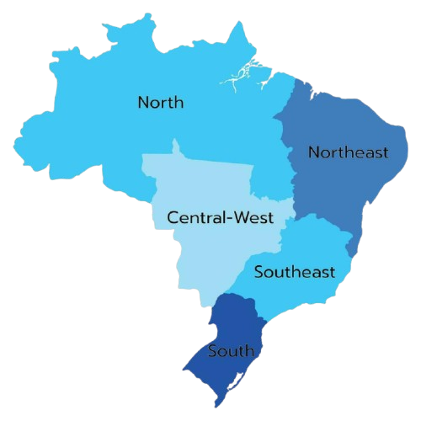




Customers Distribution Across Regions
Northeast
65.9K
South
1.7K

Slide 11
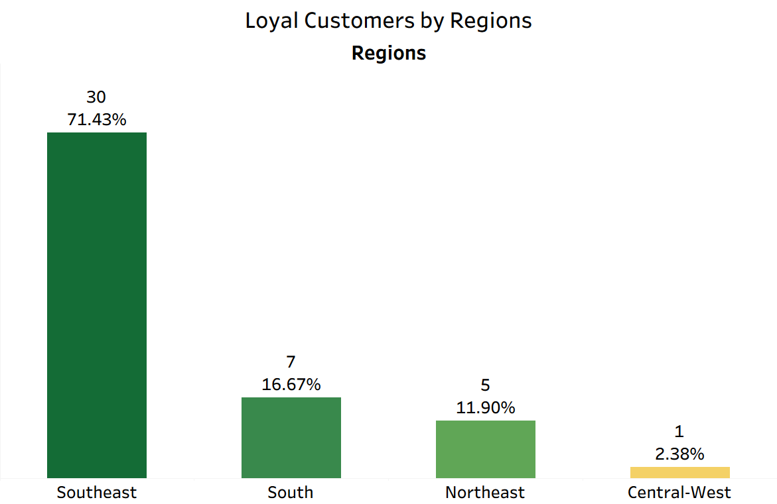
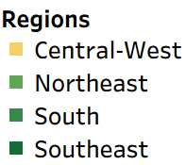

Slide 12

Customer Behaviour

Slide 13
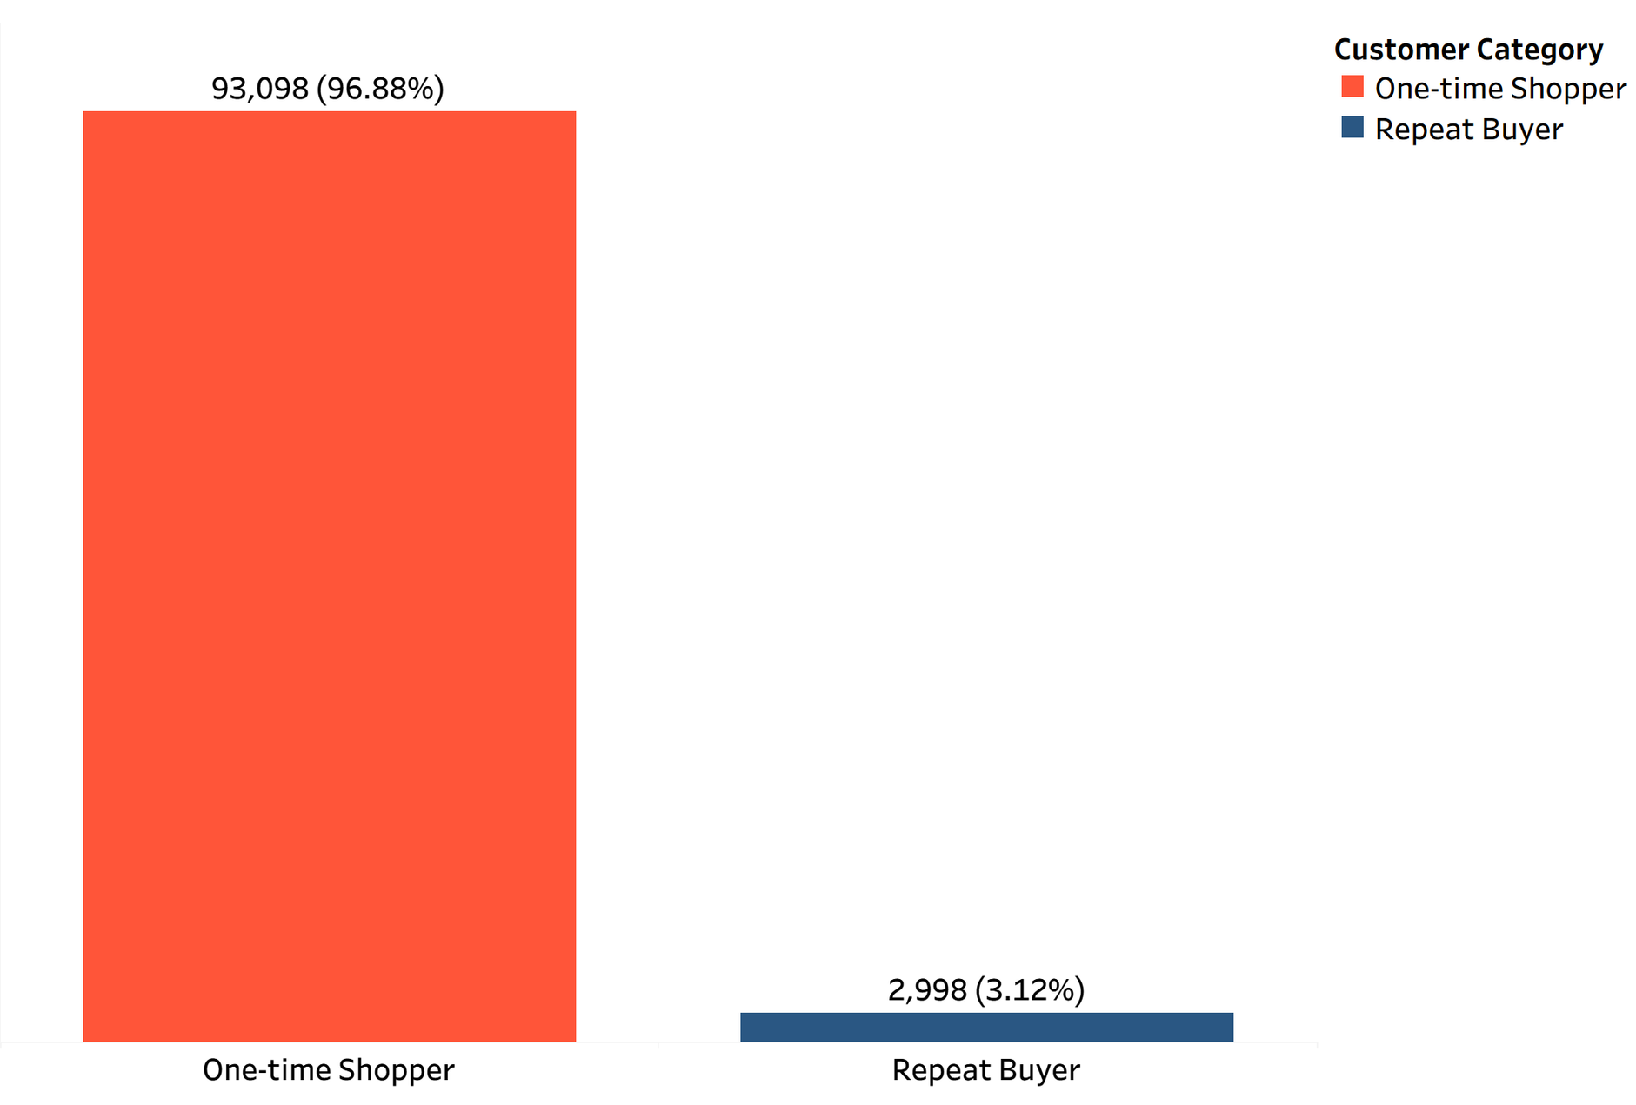
Buyers Segments as Number of Customers

Slide 14

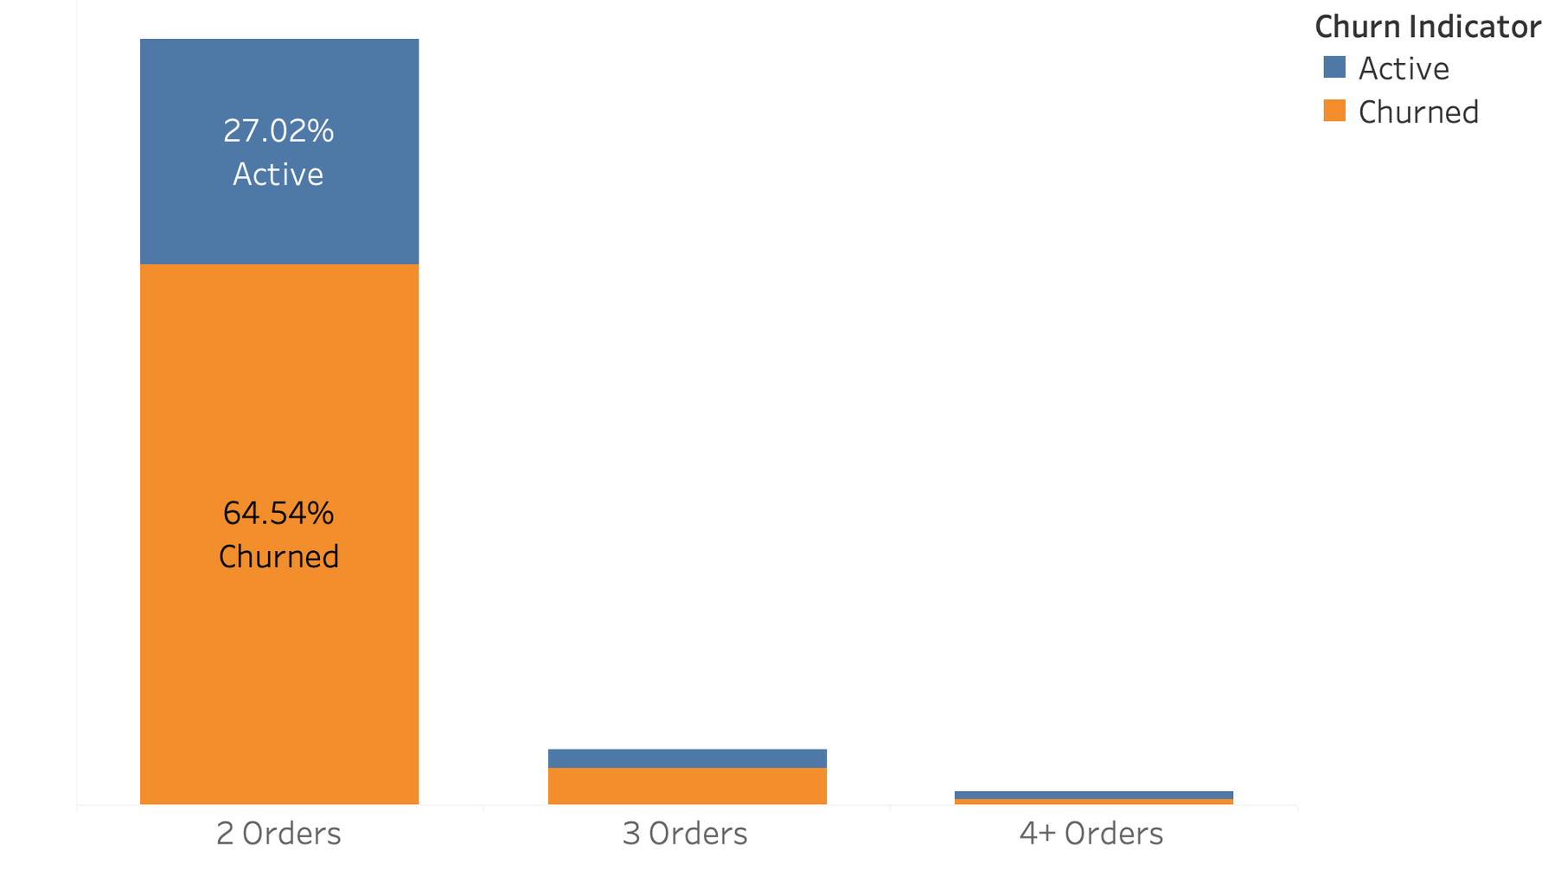


Loyal vs. Churned Customers Based on Orders
4.47%
Churned
2.30%
Active

Slide 15
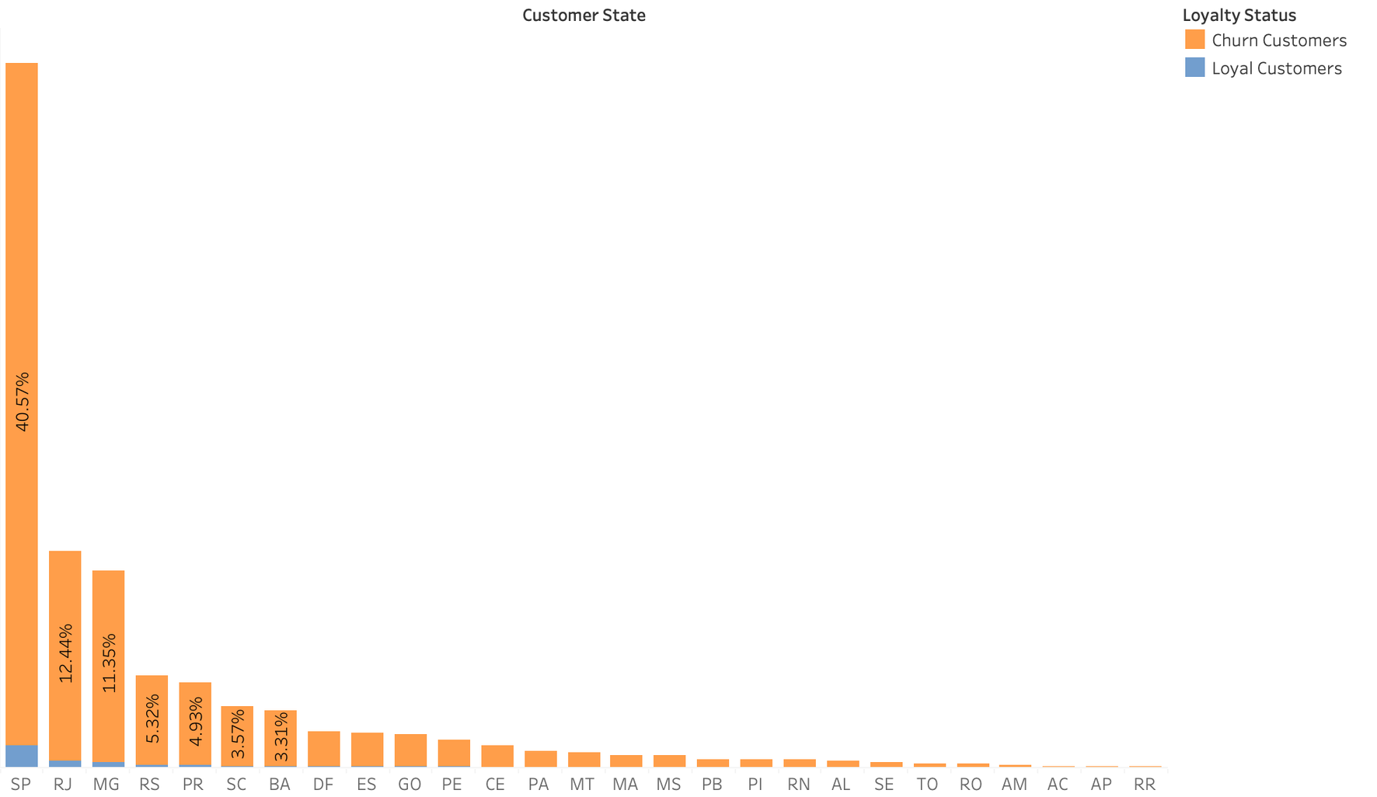
Segments are churning by State Based on Orders

Slide 16
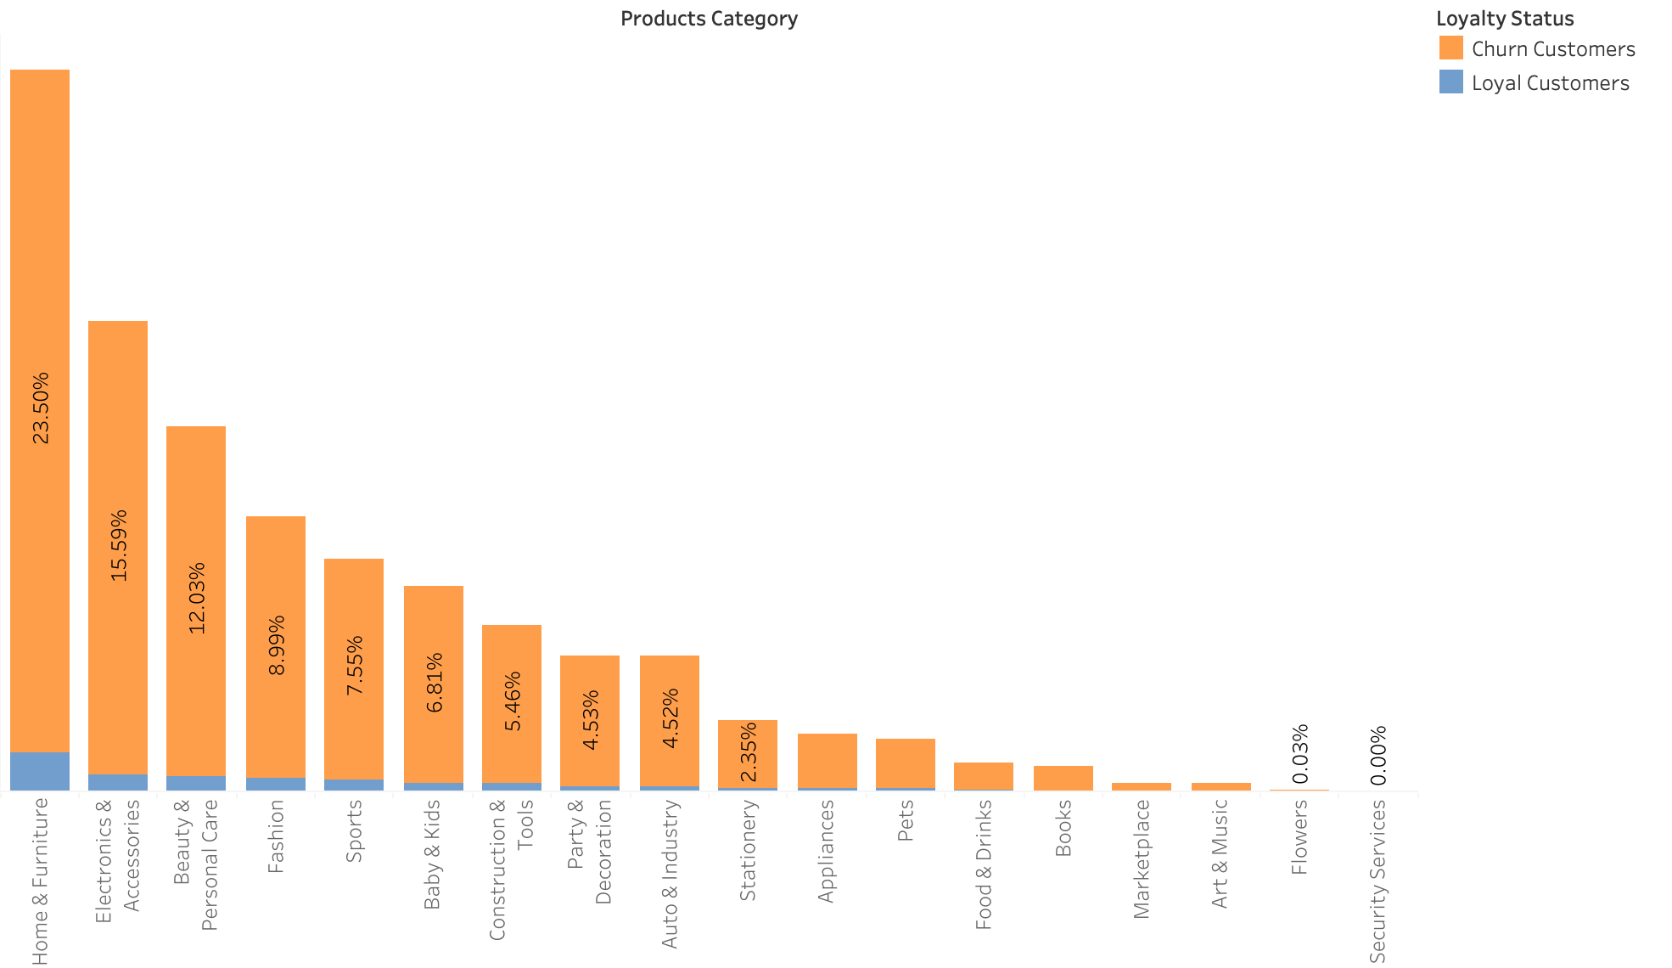
Segments are churning by product category Based on Orders

Slide 17
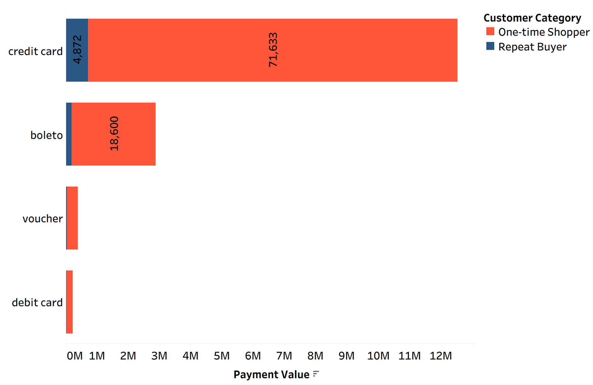
Payment Type per Customer Segment

Slide 18
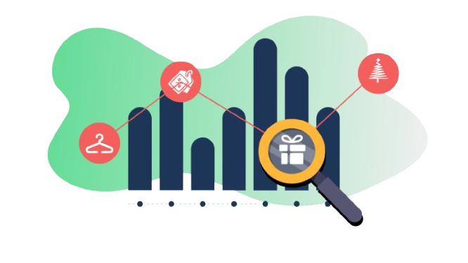
Seasonal Patterns

Slide 19
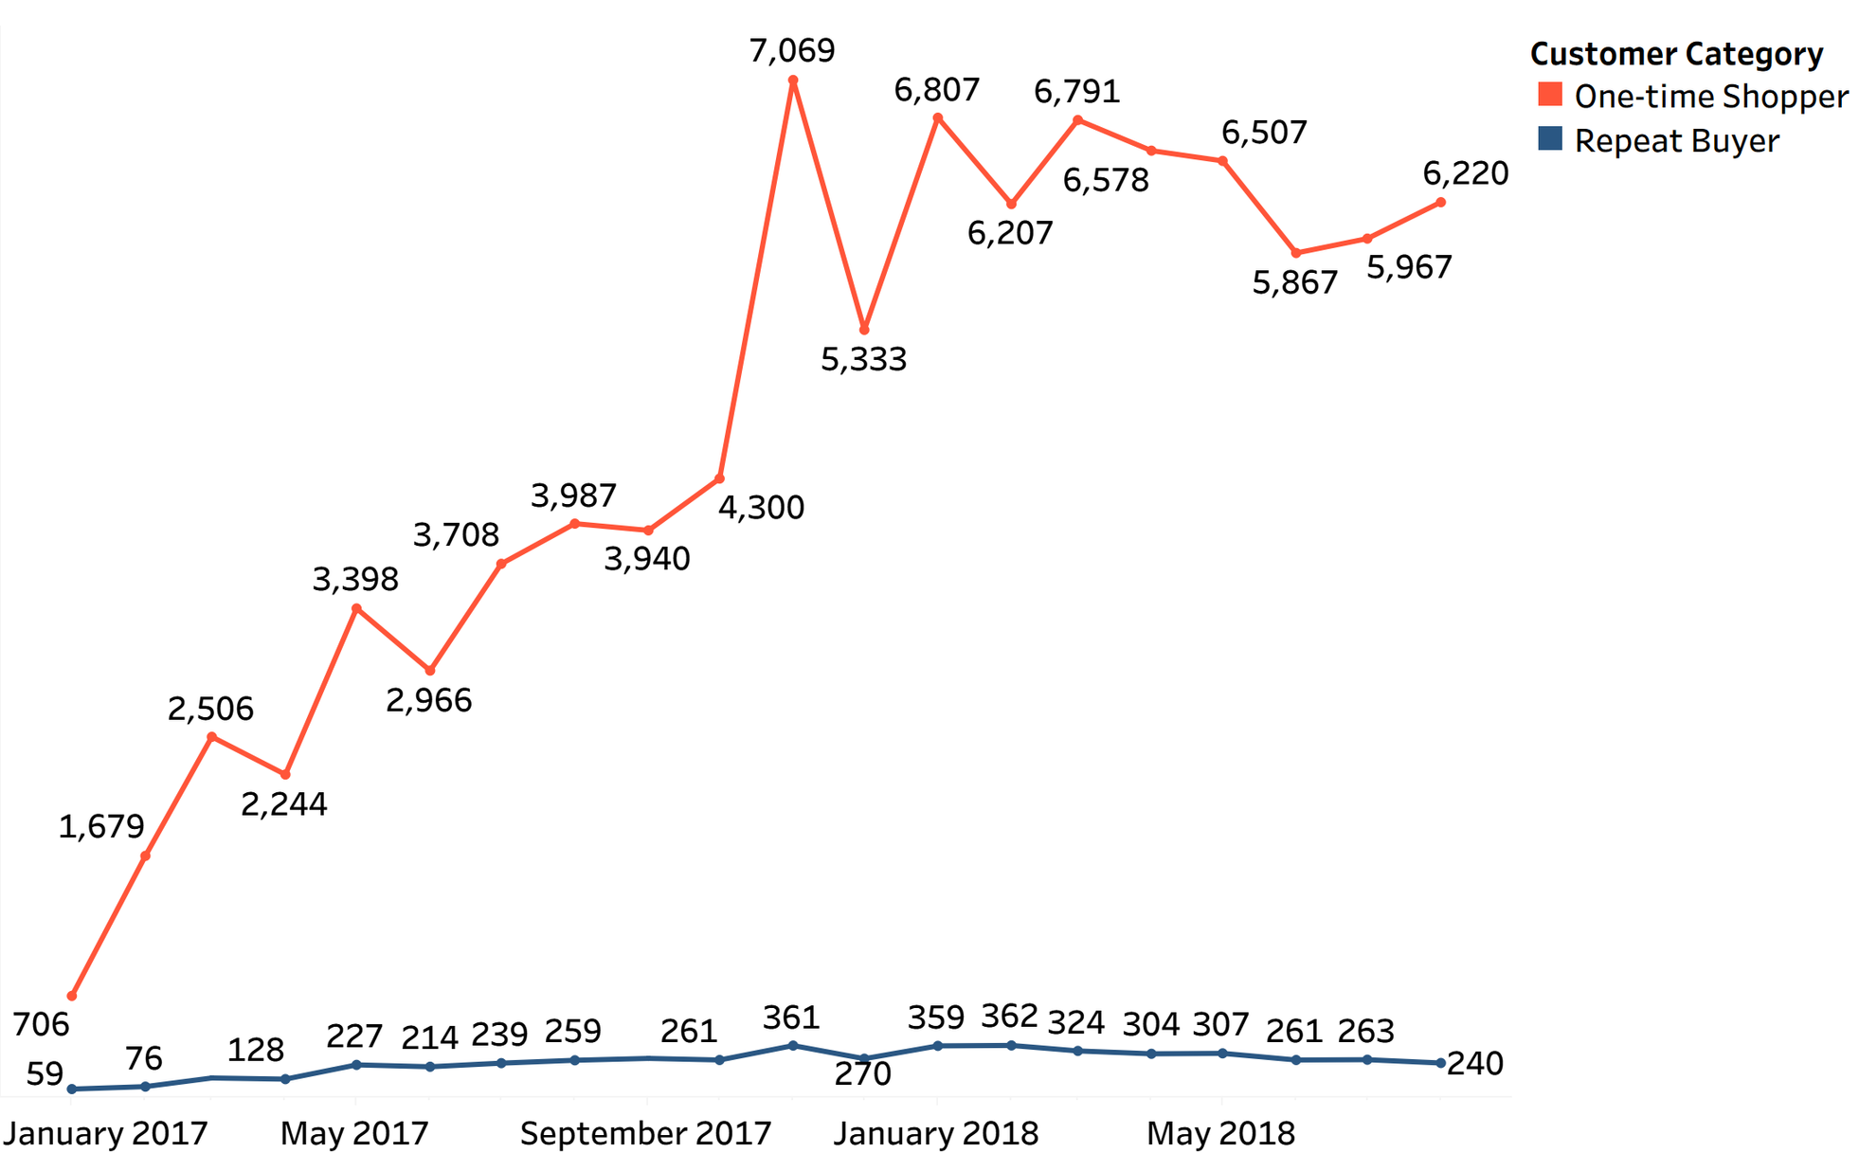
Customer Segment by Month

Slide 20
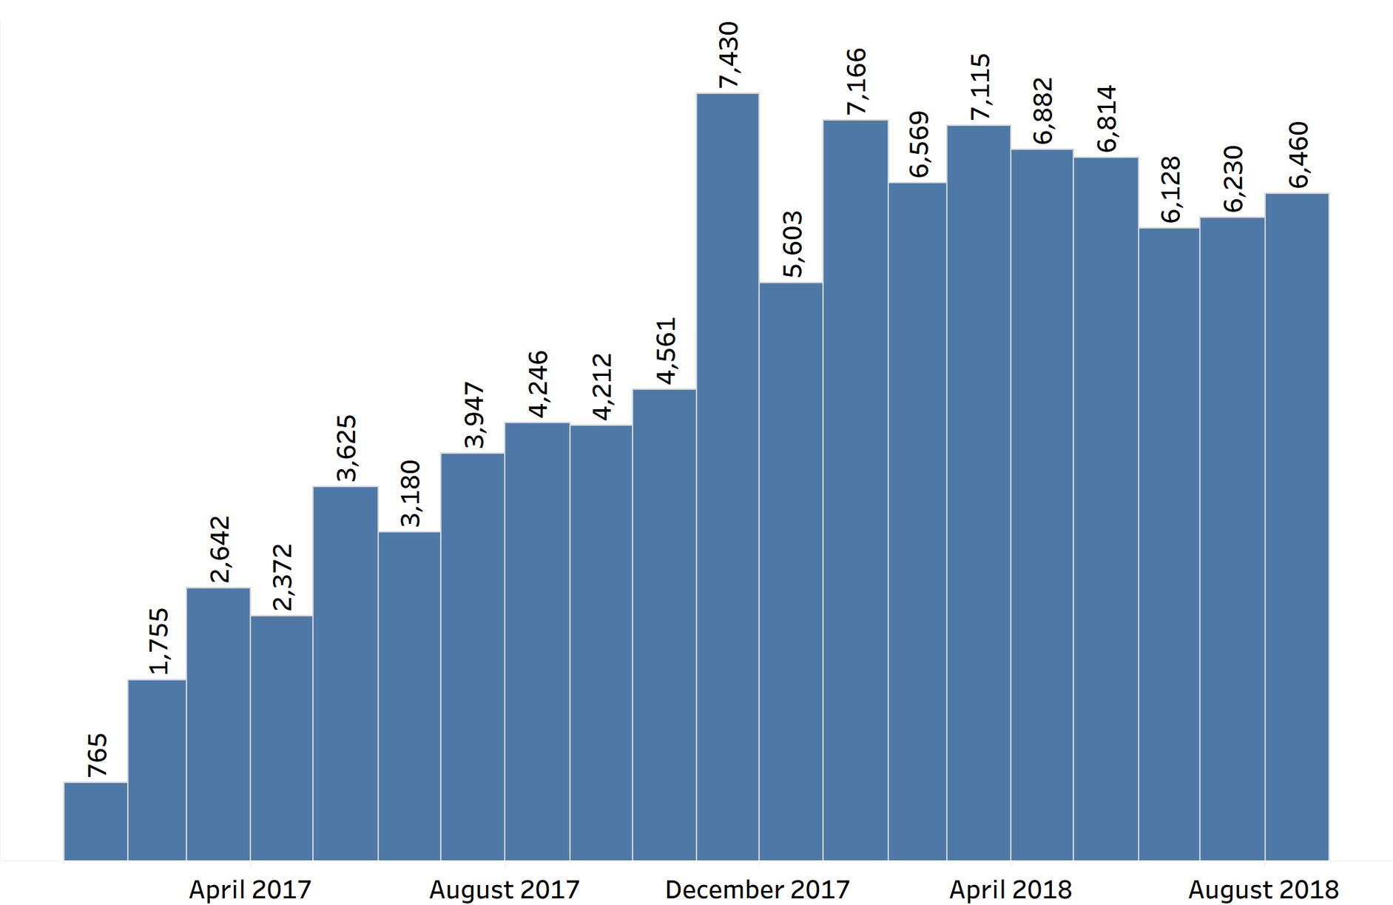

The Seasonal Patterns of Gaining Customers

Slide 21
The Seasonal Patterns of Gaining Customers

Slide 22
The Seasonal Patterns of Gaining Customers

Slide 23
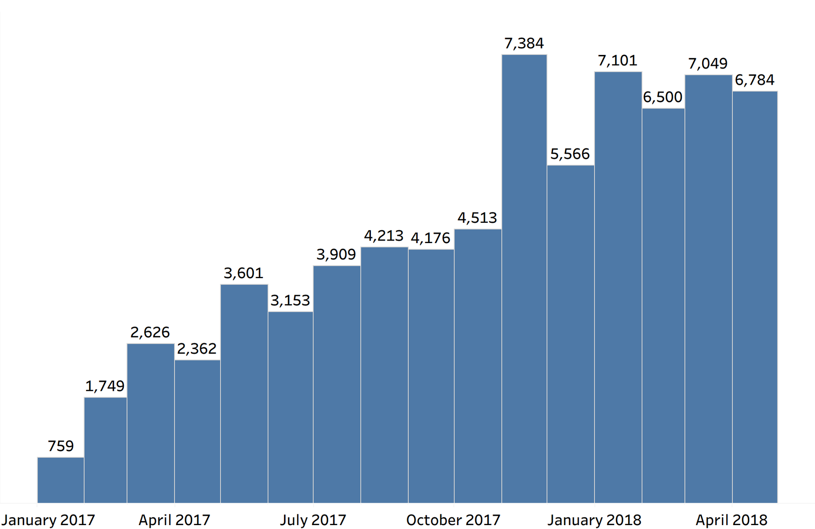
The Seasonal Patterns of Losing Customers

Slide 24
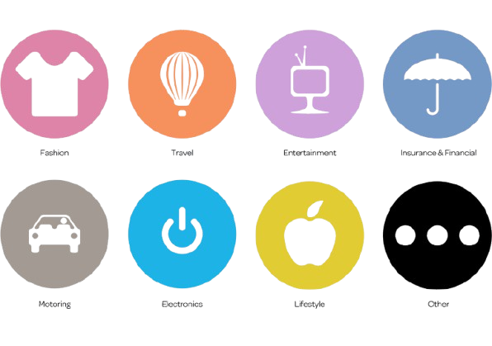
Product Categories

Slide 25
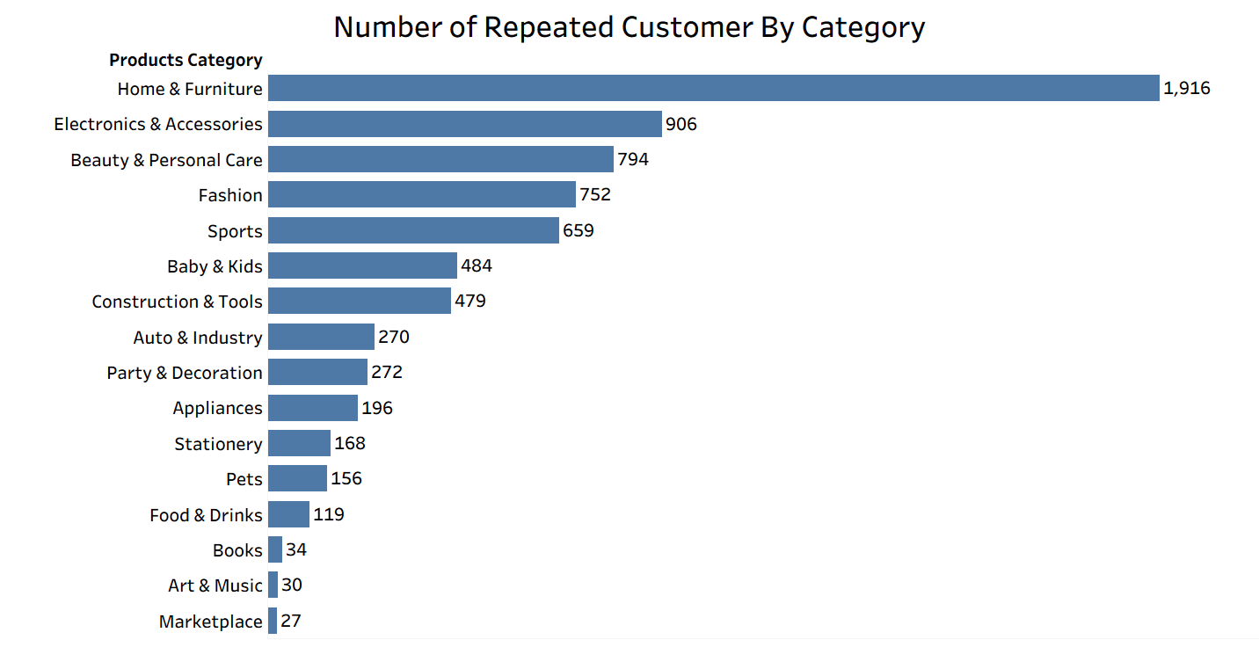

Slide 26

Customer Reviews

Slide 27
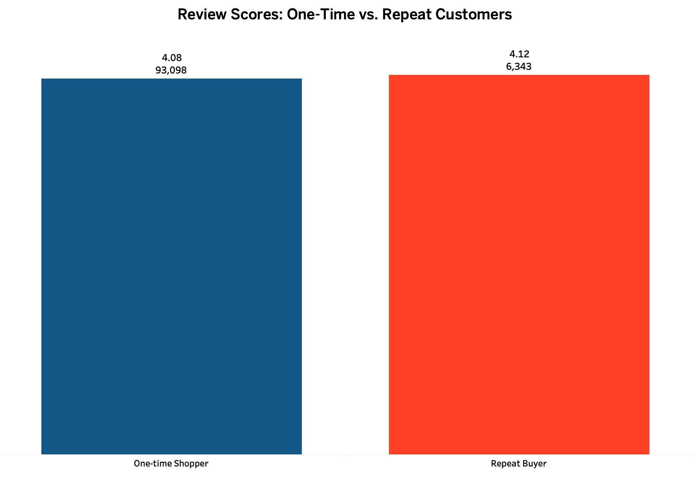

Slide 28
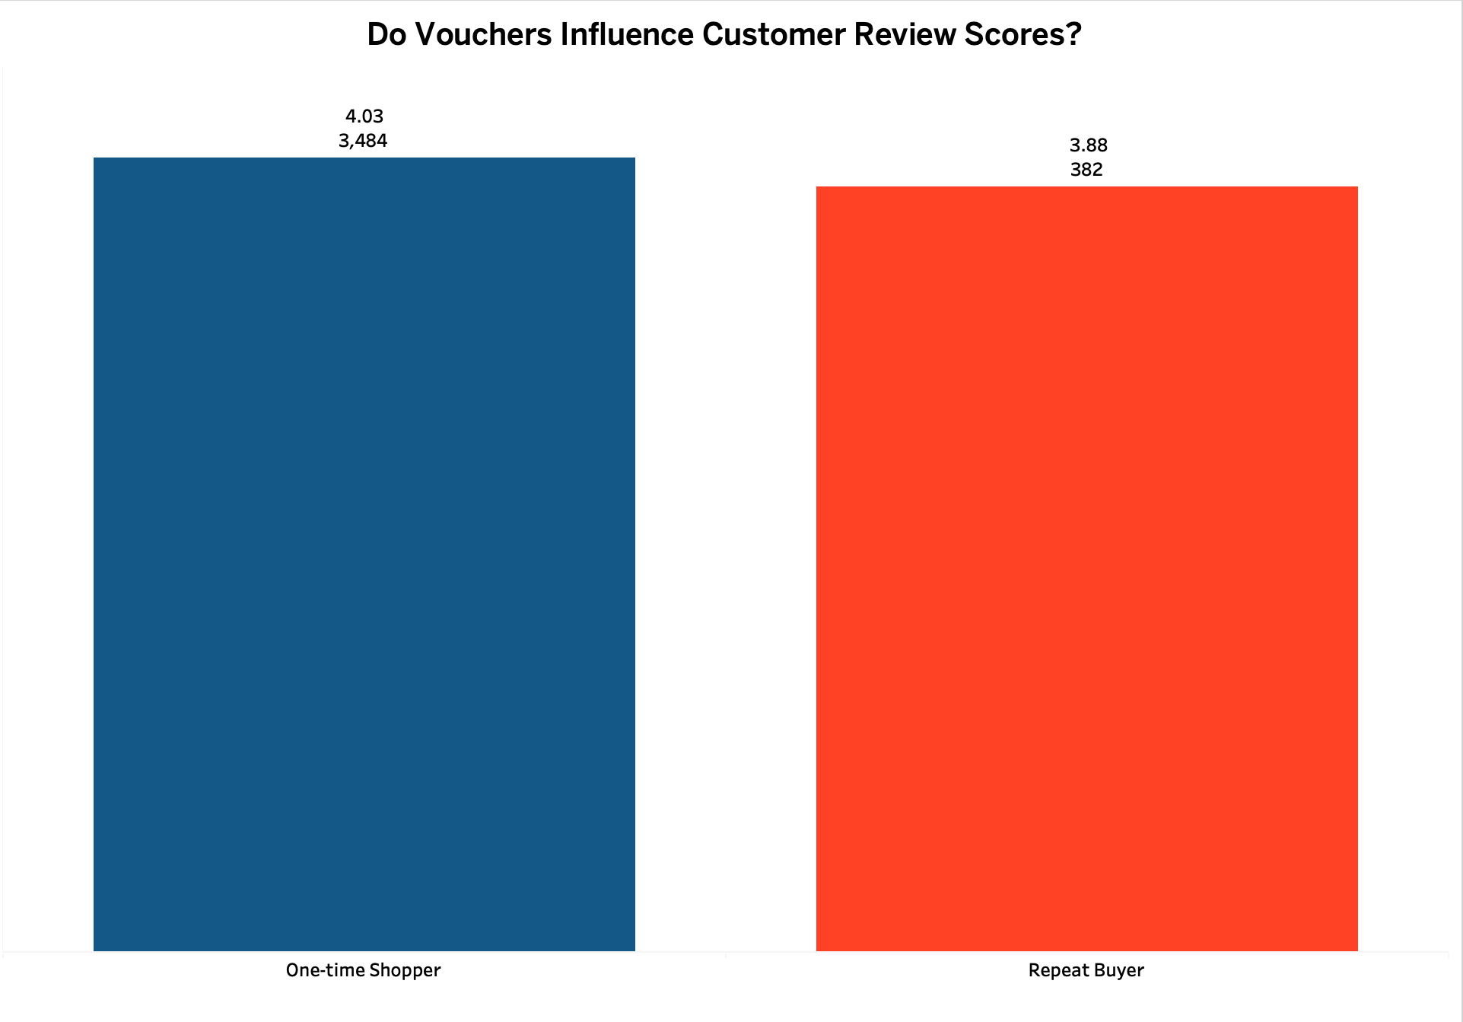

Slide 29
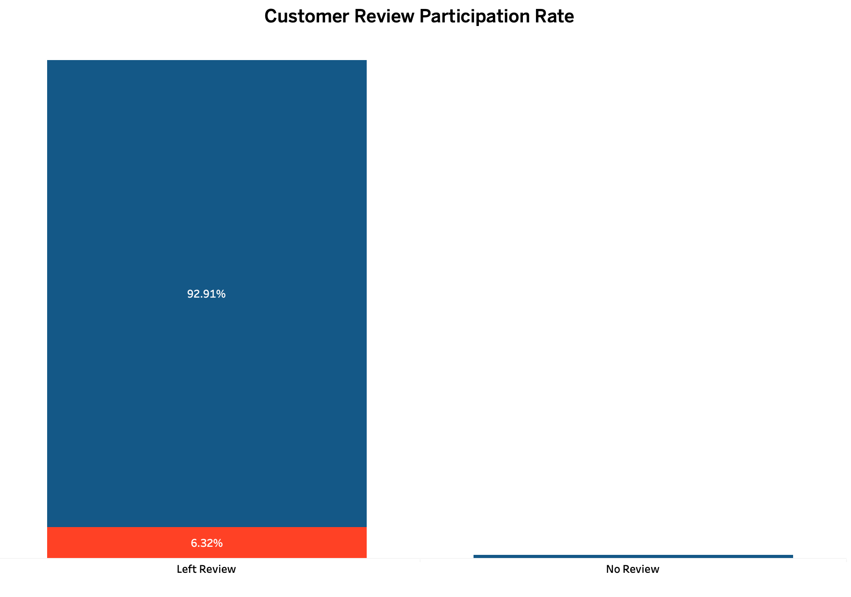

Slide 30

Delivery Time

Slide 31
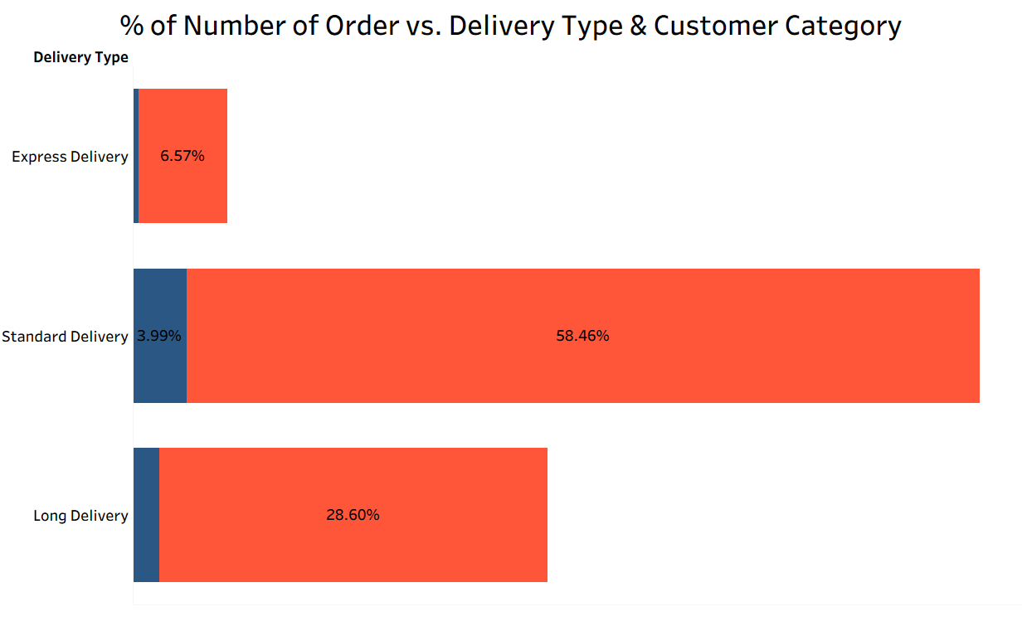
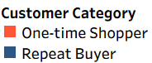

Slide 32
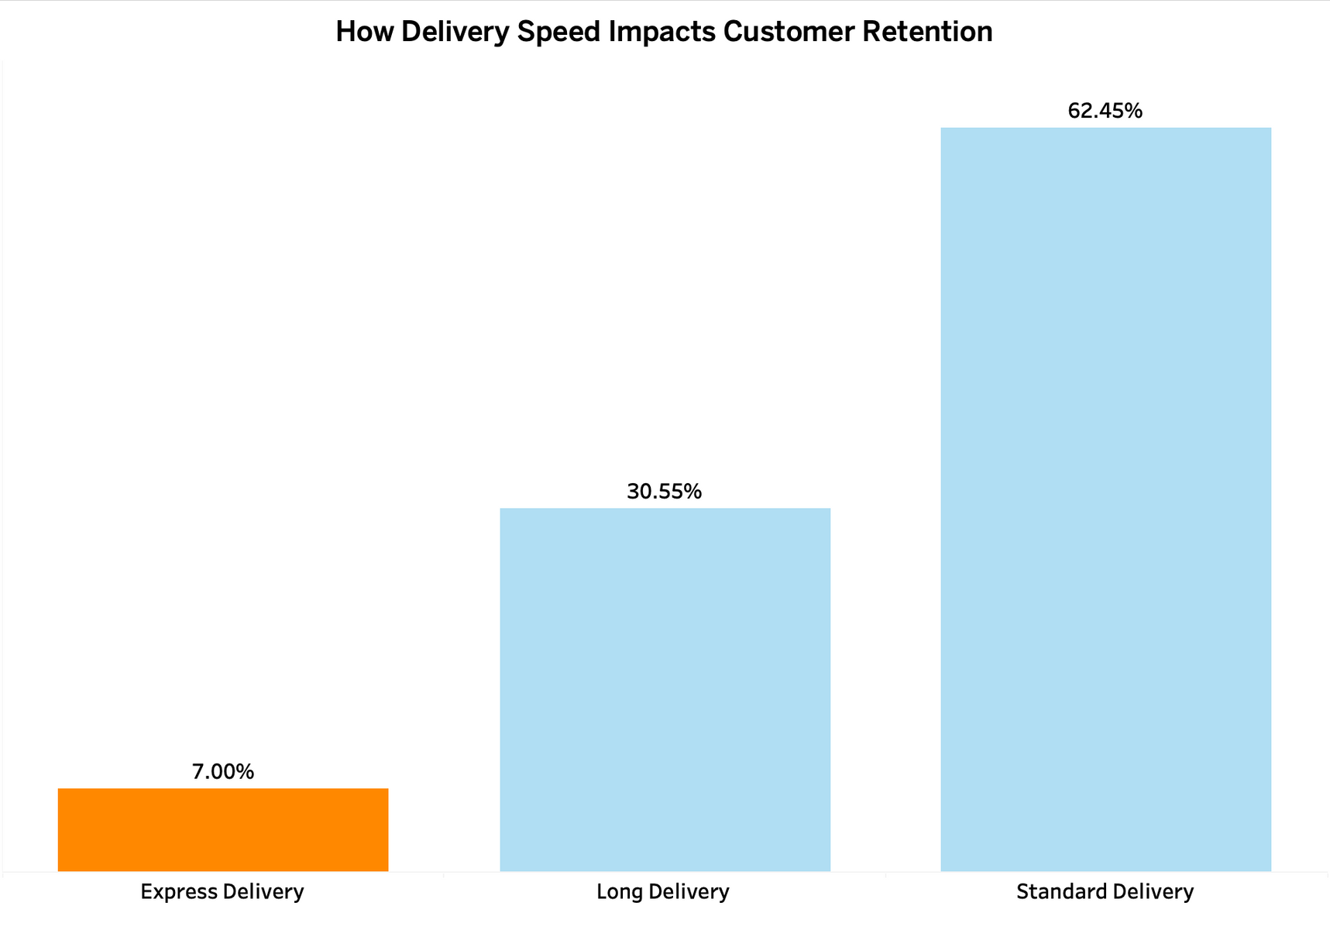
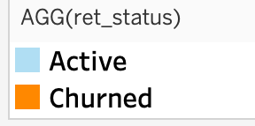

Slide 33

Customer Lifetime Value

Slide 34




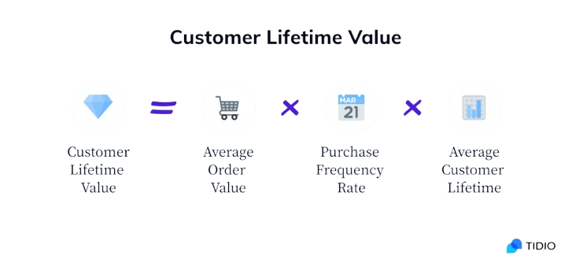

Customer Lifetime Value:
“CLV estimates the total revenue and profit a customer generates from their first purchase to their last.”

Slide 35




R$ 178.9
CLV for Olist !!!

Slide 36








CLV Comparison:
EPRG:
OLIST:
~R$ 800–2,000.
R$ 178.9
Less “Valuable”
One-time
Low-spend

Slide 37
02
Recommendations

Slide 38






Improve Delivery Speed:
Add Olist Badge

Slide 39




Focus on Categories
“Home & Furniture”
“Eectronics & Accesoris”
Offer Subscription Discounts.

Slide 40
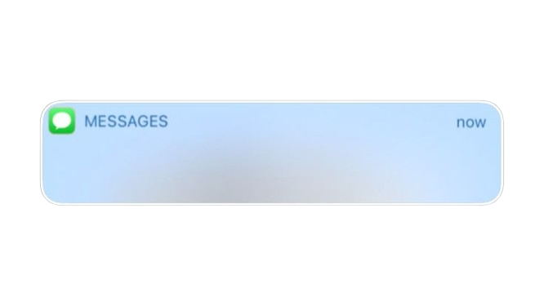




Personalized Discounts for “One Time”:
“Welcome Back! Enjoy 10% off your next purchase”.

Slide 41


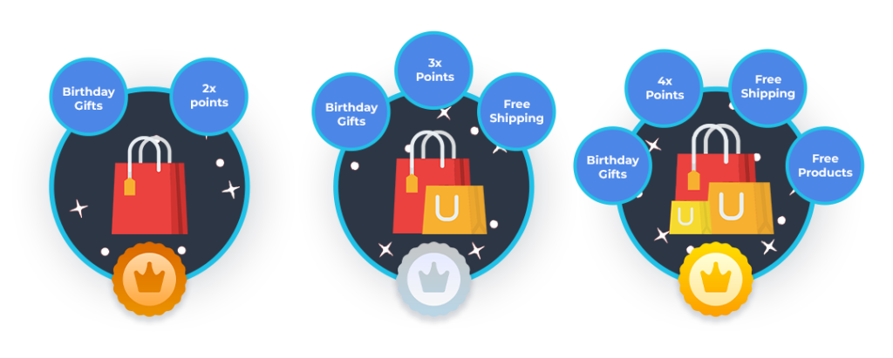
Loyalty Tier System:
Bronze
Silver
Gold
1 Purchase.
2-3 Purchases.
+ 4 Purchases.

Slide 42

Launch a points system for writing reviews
“Leave a quick review and
collect loyalty points”

Slide 43
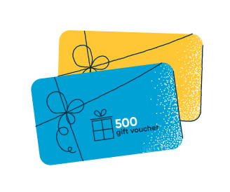
Offer Vouchers
Vouchers act as a reason to return, especially for one-time shoppers

Slide 44
03
Limitation

Slide 45










Limitation
1- Missing or incomplete records
2- No demographic information
3- Time limit

Slide 46




Thank You For
Listening !

